Slide 1

Manually edit Ethercat Pdo’s in Esi file
Anthony Redamonti

Slide 2
Overview
Background
ESI file format
MDP Protocol
How to properly map a PDO using an SDO initialization sequence
Don’t have an SDO initialization sequence? Edit the ESI file manually.

Slide 3
EtherCAT Slave Information (ESI) File
Provides information about the slave to the master.
Object Dictionary: Object Indices, Size, Data type, Description
2 types: Flats and Slots
Only difference: Slots support Modular Device Protocol (MDP) and flats do not.

Slide 4
Modular Device Protocol (MDP)
Provides convenient modules for the user to select
Each module corresponds to a cyclic mode of operation that the user may want to use
Cyclic Synchronous Position (CSP), Cyclic Synchronous Velocity (CSV), Cyclic Synchronous Torque (CST), etc.
Each module has pre-selected fixed-PDO’s that contain the necessary objects for the desired mode

Slide 5
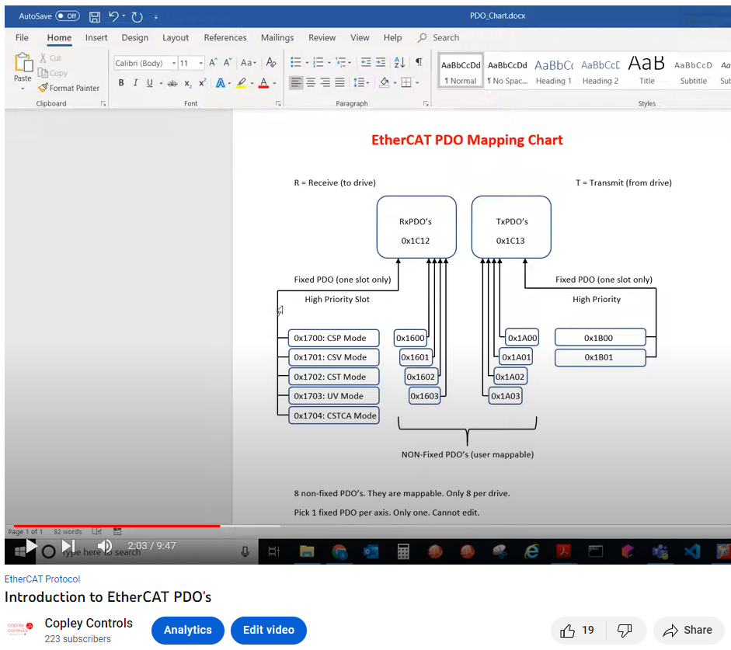

Process Data Object (PDO)
Cyclic data sent at a fixed rate (constantly sent, very fast)
Service Data Object (SDO)
Acyclic data sent once
Used for one-time settings or intermittent messages

Slide 6
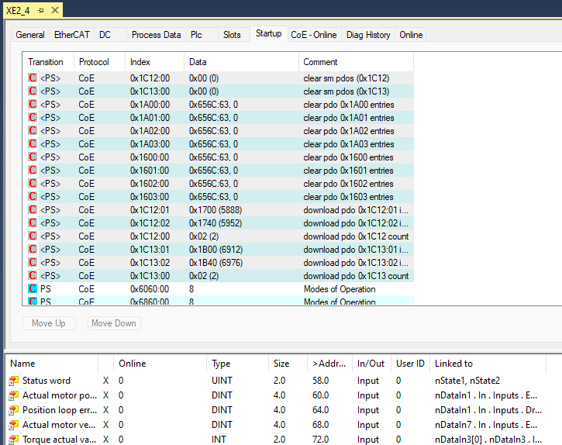
SDO Initialization Sequence: TwinCAT (Beckhoff)
When do PDO’s get mapped?
On system startup, the master sends SDO’s to map the PDO’s, known as an SDO initialization sequence
TwinCAT’s Startup tab on the right

Slide 7
SDO Initialization Sequence: Trio EtherCAT PLC
Trio’s SDO Init Sequence looks very similar to TwinCAT’s Startup Tab!
Edit PDO Mapping
Set Application Specific Parameters
Mode of Operation
Interpolation Time Period
Sync Manager Settings

Slide 8
Manually edit esi file
If the master does not have an SDO initialization sequence, the PDO mapping can be edited manually
Use the Entry property of the non-fixed PDO’s
There are 8 non-fixed PDO’s in total: 4 RxPDO’s (0x1600-0x1603) and 4 TxPDO’s (0x1a00-0x1a03)
Each non-fixed (editable) PDO can map up to 32 bytes of data
<TxPdo Fixed="0"> <Index>#x1a00</Index> <Name>Transmit PDO 1</Name> <Entry> <Index DependOnSlot="0">#x219a</Index> <SubIndex>0</SubIndex> <BitLen>32</BitLen> <Name>General purpose inputs</Name> <DataType>UDINT</DataType> </Entry> </TxPdo>

Slide 9
Common Data types to map in a PDO
Data Type | <DataType> in ESI File
Signed Byte (8 bits) | SINT
Unsigned Byte (8 bits) | USINT
Signed 16-bit Integer | INT
Unsigned 16-bit Integer | UINT
Signed 32-bit Integer | DINT
Unsigned 32-bit Integer | UDINT

Slide 10
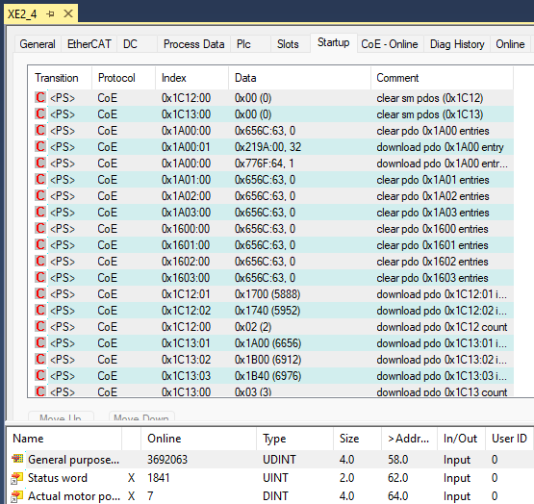
Twincat’s startup tab after editing Esi file
TwinCAT automatically added SDO’s to map TxPDO1 (0x1a00)
TxPDO1 is added to SM3 (0x1C13.1), and its contents are displayed in real time (general purpose inputs)

Slide 11


Thank You
aredamonti@copleycontrols.com

